Slide 1
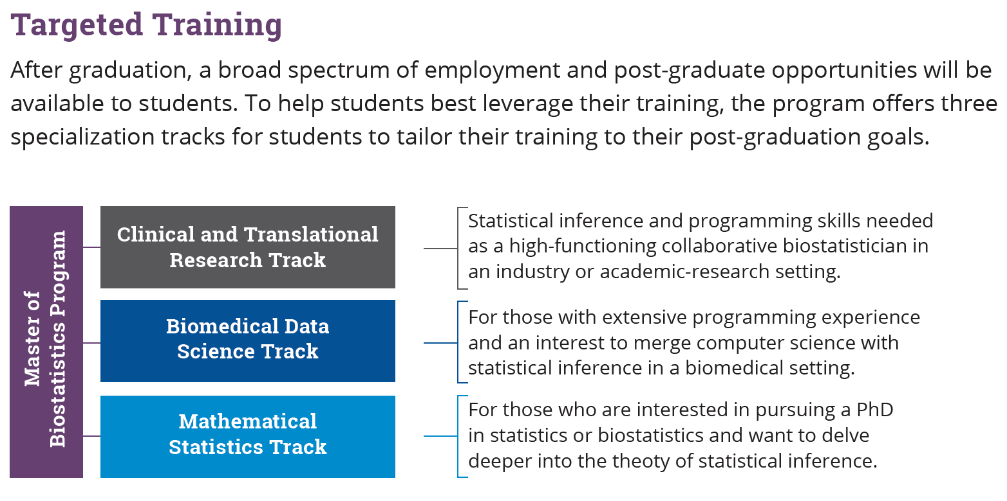
This two-year program prepares aspiring biostatisticians and data scientists to make outstanding contributions to biomedical research in academic, government, and industry settings.
Faculty Practice What They Teach All students take courses designed to prepare them to enter this fast-paced, ever-evolving field.
Integrative Research Experiences All students participate in collaborative internships with world-class biomedical researchers at Duke.
Formal Career Preparation and Development All students receive training in career-savvy skills like networking and creating a digital presence.
The MB program at Duke is a unique experience. The faculty and staff go above and beyond to make sure their students succeed and the research opportunities in the area are unparalleled. Regardless of your goal after graduation, academia or industry, you can find opportunities that will prepare you for your future career. – Emily Perry, MB Class of 2017
The interns and graduates who have come to work with us have been well prepared with a solid base of statistical and programming knowledge, good communication skills, and an enthusiastic desire to learn, contribute, and be part of our team. – Terry Weber Sosa, Vice President, QuintilesIMS

Slide 2
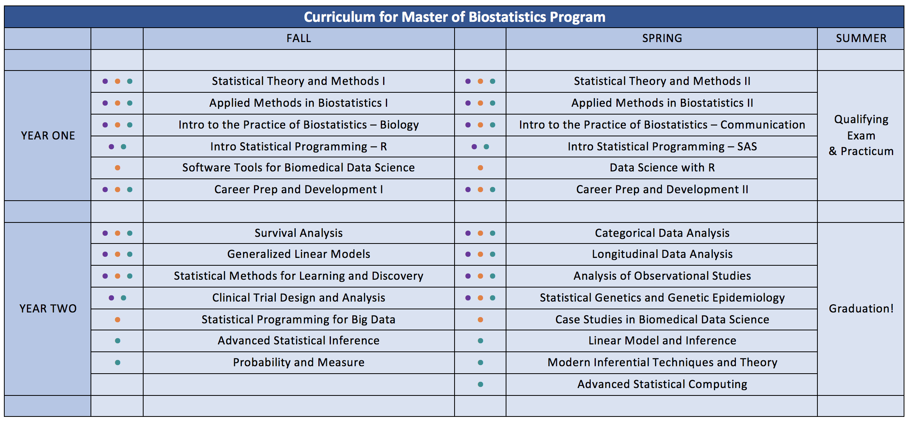
Where Do Students Land After Graduation?
As statistical programmers, biostatisticians, and data scientists at leading institutions such as:
Quintiles, Rho, PPD, INC Research, Astellas Pharmaceuticals, PAREXEL, Novella, Blue Cross Blue Shield, Cigna, Boehringer Ingelheim, Duke Clinical Research Institute, Fred Hutchinson Cancer Research Center, Lieber Institute at Johns Hopkins
As doctoral students in competitive PhD programs in statistics and biostatistics such as:
North Carolina State University, University of Michigan, Boston University, University of Pennsylvania, Penn State, University of North Carolina, Duke University
60% of students are placed within 1 month of graduation
All students are placed within 3 months of graduation
Questions? We are here to help! Email: biostat-admissions@duke.edu

