Slide 1
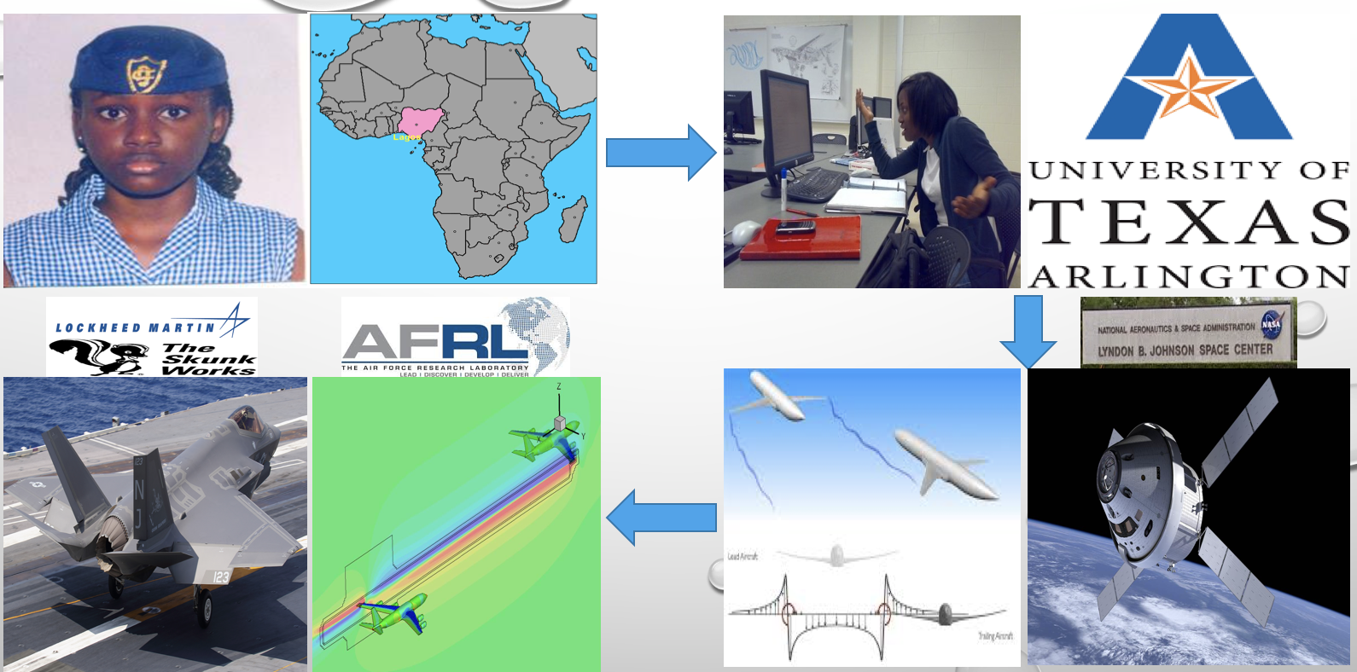
wendy A. Okolo, ph.d. (NASA Ames Research Center)

Slide 2
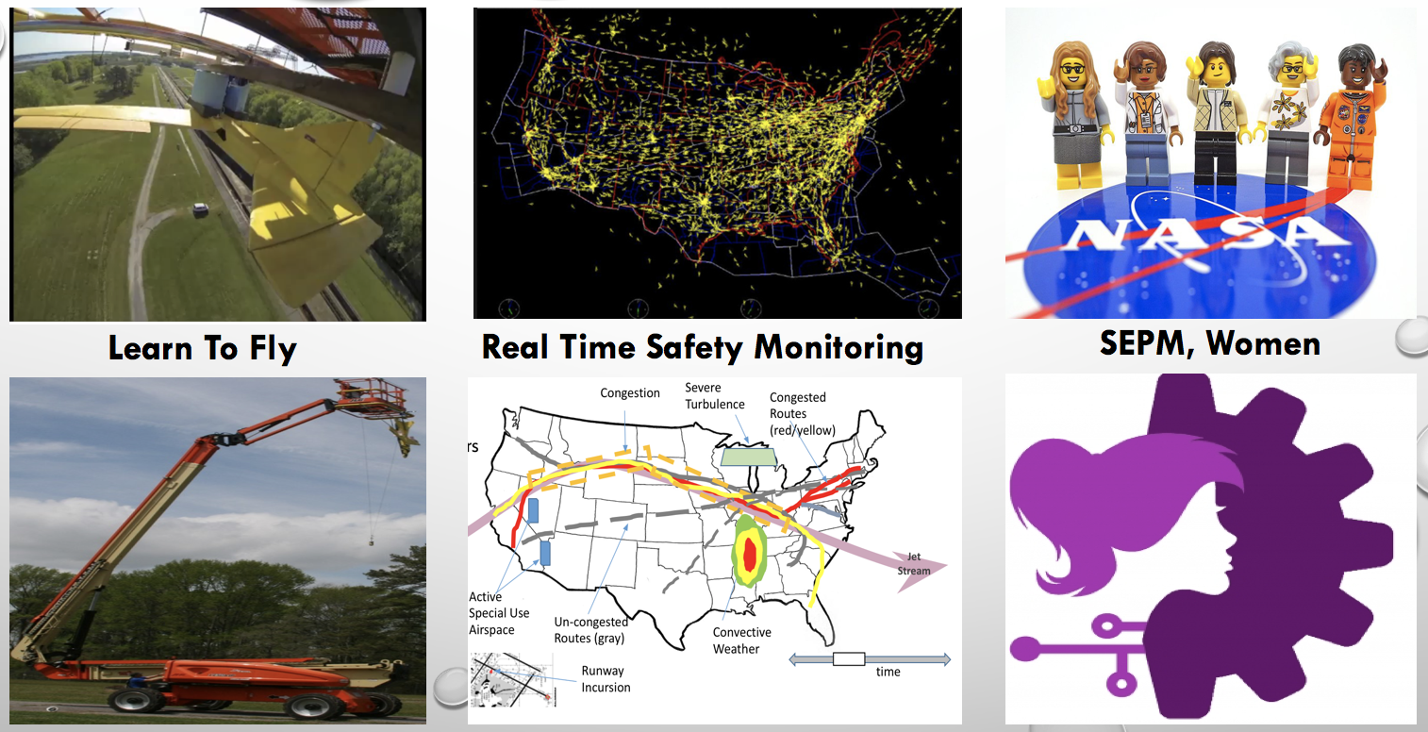
wendy A. Okolo, ph.d. (NASA Ames Research Center)

